Slide 2
FIT 152 Fundamentals of Information Technology
Lecture 3
Topic 2: History of Information Technology

Slide 3
FIT 152: Module outcomes
Upon successful completion of this course, the student will be able to:
Demonstrate an understanding of the relationship between IT and related and informing disciplines.
Demonstrate insight in the history of computing technology, and an understanding of the Internet, and the World-Wide Web, as well as the components of an IT system and how they interrelate.
Demonstrate an understanding of complexity in an information technology environment and how and why it occurs.
Demonstrate an understanding of why life-long learning and continued professional development is critical for an IT professional.
Illustrate the use of information and communication technologies to solve problems.
Demonstrate an understanding of how and to what extent IT has changed various application domains.

Slide 4
Introducing technology (1 of 3)
Read module 1, (pages 1-1 to 1-31), of this book (up to just before “Technology Uses”): Vermaat2018
A computer is an electronic device, operating under the control of instructions stored in its own memory, that can accept data (input), process the data according to specified rules, produce information (output) and store the information for future use.
Hardware: Electric, electronic and mechanical components
Software: Collection of related instructions organised for a common purpose
Categories of computers
Personal computer – laptops, tablets, desktops
Servers
Mobile and game devices – smart phones, digital cameras, portable and digital media players, e-book readers, wearable devices, game devices
Data and Information
Input devices – keyboard, pointing devices (mouse, touchpad), voice and video input, scanners
Output devices – printers, displays, speakers, earbuds, headphones

Slide 5
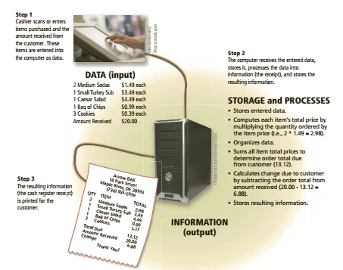

Slide 6
Introducing technology (2 of 3)
Read module 1, (pages 1-1 to 1-31), of this book (up to just before “Technology Uses”): Vermaat2018
Memory and Storage
Hard disks, USB flash drives, memory cards, optical disk, cloud storage
The Web
World Wide Web vs Internet
Browsing the Web – Chrome, Edge, Firefox, Safari
Searching the Web - Google
Online social networks
Facebook, X, LinkedIn, Instagram
Internet communications
Email, VoIP, File Transfer Protocol (FTP), Video conferencing, social media, discussion forums…..
Digital security and privacy
Viruses and other malware
Passwords
Notes:
Internet communications encompass various methods of transmitting data, information, and messages over the Internet. Here are some of the different types:
Email: Electronic mail allows users to send messages, files, and documents to other users via the Internet. It's one of the oldest and most widely used forms of Internet communication.
Instant Messaging (IM): IM allows real-time text-based communication between users over the Internet. Popular IM platforms include WhatsApp, Facebook Messenger, and Slack.
Voice over Internet Protocol (VoIP): VoIP technology enables voice communication over the Internet. Services like Skype, Zoom, and Google Meet allow users to make voice calls, video calls, and conference calls over the Internet.
Video Conferencing: This is an extension of VoIP that allows users to conduct face-to-face meetings over the Internet. Platforms like Zoom, Microsoft Teams, and Cisco Webex provide video conferencing capabilities.
Social Media: Social media platforms facilitate communication and interaction between users through text, images, videos, and other multimedia content. Examples include Facebook, Twitter, Instagram, and LinkedIn.
Discussion Forums and Message Boards: These platforms allow users to post messages and engage in discussions on various topics. Examples include Reddit, Quora, and Stack Exchange.
Blogging and Microblogging: Blogging platforms like WordPress and Blogger enable users to publish long-form content, while microblogging platforms like Twitter allow users to share short messages and updates.
File Transfer: File transfer protocols like FTP (File Transfer Protocol) and SFTP (Secure File Transfer Protocol) enable users to upload and download files over the Internet.
Virtual Private Networks (VPNs): VPNs provide secure communication over the Internet by creating a private network connection over a public network. They're commonly used for remote access to corporate networks and for ensuring privacy and security online.
Web-based Communication Tools: These include webmail services like Gmail, collaborative document editing tools like Google Docs, and project management platforms like Trello, which enable real-time collaboration and communication over the Internet.
These are just a few examples of the diverse range of Internet communications available today, each serving different purposes and catering to various communication needs.

Slide 7
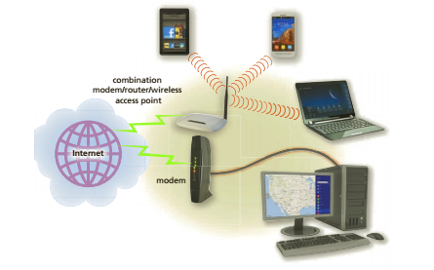
Introducing technology (3 of 3)
Read module 1, (pages 1-1 to 1-31), of this book (up to just before “Technology Uses”): Vermaat2018
Programs and Apps
Software, also called a program – systems software and application software
Systems software – operating system (Windows, iOS, Android)
Applications – categories:
Productivity, graphics and media, personal interest, communications, security
Communications and networks
Wired and wireless communications – modems, wireless access points, routers
Networks

Slide 8
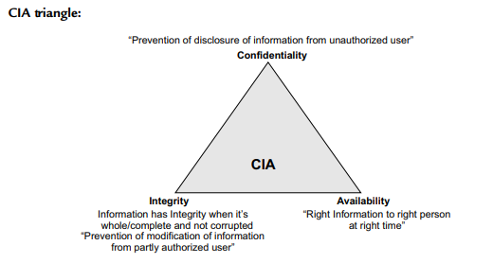
Social impact of computers
Read this book: Gupta2020, pages 18 to 23, up to just before “1.8 Information Assurance”.
Cybercrime
Need for Information Security

Slide 9
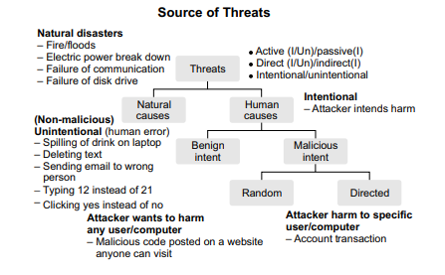
Social impact of computers
Read this book: Gupta2020, pages 18 to 23, up to just before “1.8 Information Assurance”.
Threats to Information Systems

Slide 10
Development of user interaction
Three generations of human-computer interaction (HCI):
First generation – green screens and keyboards
Second generation – Screen technologies, pointing devices, graphical user interfaces (GUI)
Third generation – wireless, cloud, virtual reality, augmented reality, location services
1. Early Interfaces (1940s-1960s): Characterized by punch cards and command-line interfaces, primarily used by experts in scientific and military fields.
2. Graphical User Interfaces (1970s-1980s): The advent of GUIs, pioneered by Xerox PARC and popularized by Apple and Microsoft, introduced icons, windows, and menus for easier interaction.
3. Web Interfaces (1990s-Present): The rise of the internet brought about web browsers and hypertext, enabling access to vast amounts of information and facilitating communication.
4. Mobile and Touch Interfaces (2000s-Present): Smartphones and tablets popularized touchscreens, gestures, and mobile apps, leading to more intuitive and portable interaction.
5. Natural User Interfaces (NUI) and AI (2010s-Present): Technologies like voice recognition, gesture control, and augmented reality aim to make interaction more seamless and intuitive, while AI-driven interfaces personalize experiences and anticipate user needs.

Slide 11
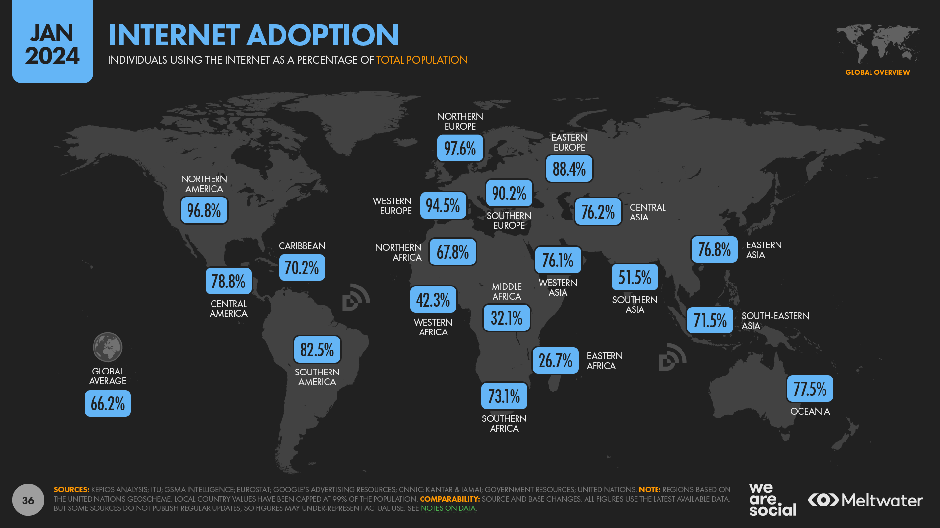

Slide 12
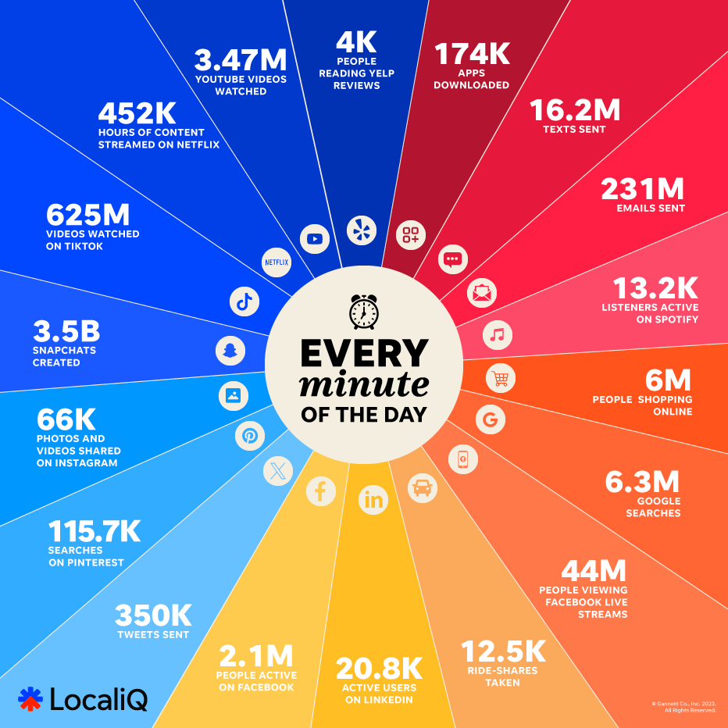

Slide 13
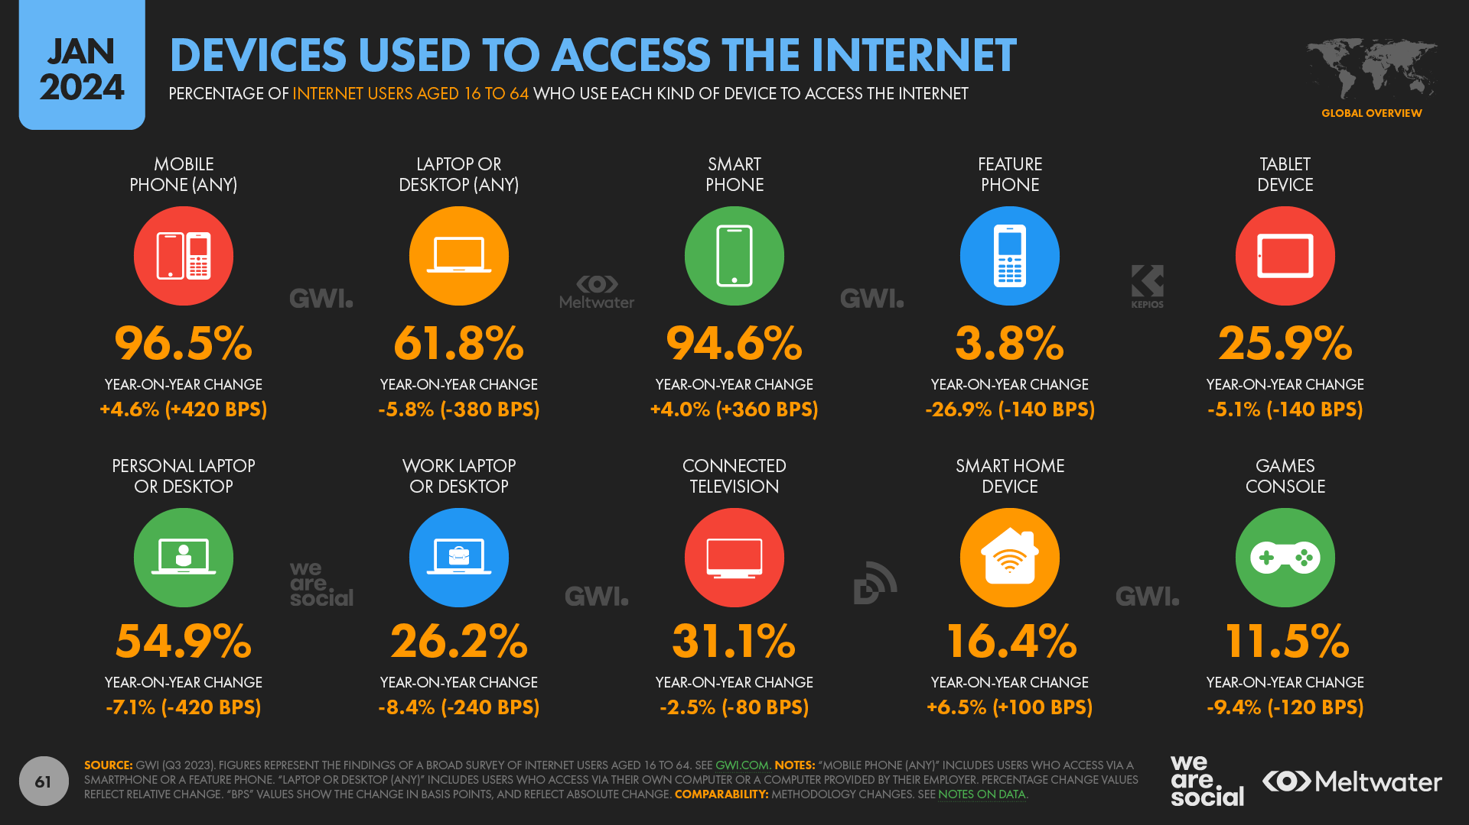
WWW and Internet

